Slide 1
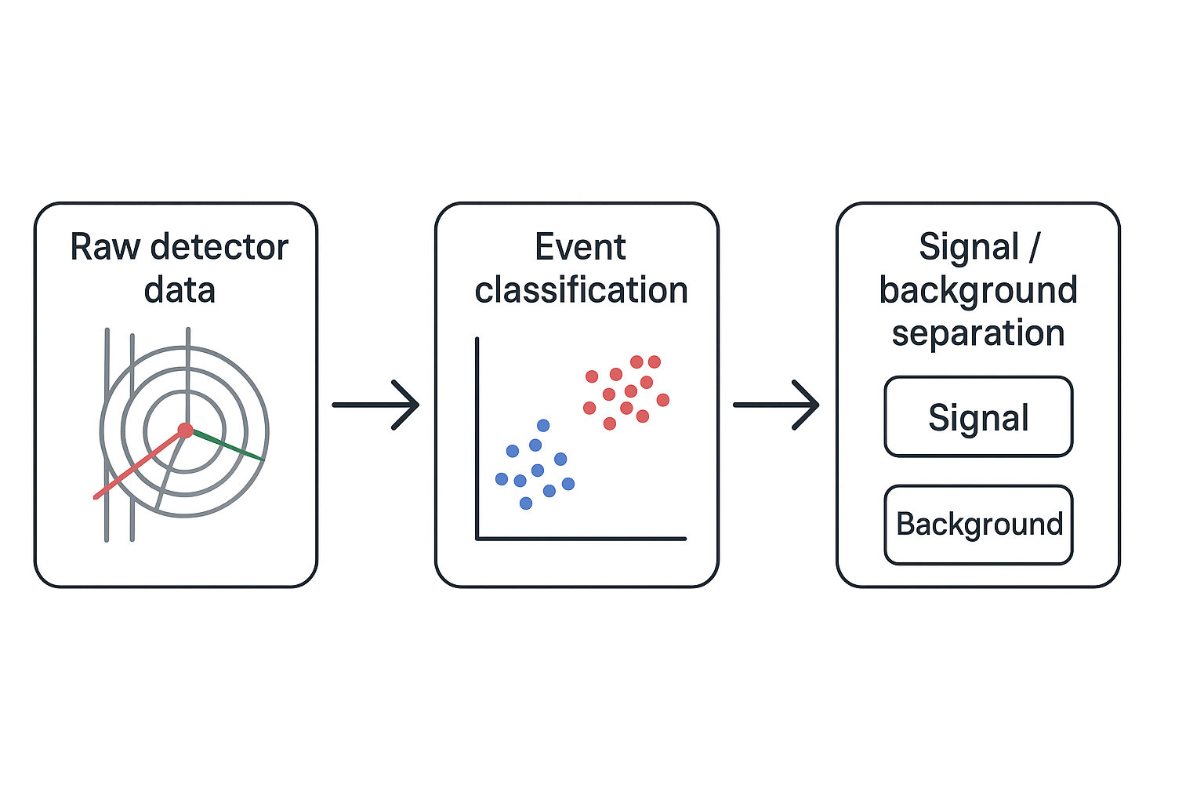
Title : Particle Physics Event Classification using Random Forest ML model : Signal Vs Background.
Problem Statement:
In the field of particle physics, accurate identification and classification of events are crucial for understanding fundamental particles and their interactions.
The provided dataset contains various features derived from particle physics experiments, and the goal is to build a machine-learning model to classify events into signal (s) and background (b) categories.
This classification aids in distinguishing events of interest (signal) from background noise.
Objective/Goal:
The primary goal of this machine learning project is to develop a model that can accurately predict whether a given set of experimental features corresponds to a signal or background event.
Successful classification contributes to the advancement of particle physics research by automating the identification of events that may indicate the presence of specific particles or phenomena.

Slide 2
1. Problem Definition
In particle physics, an event refers to the results just after a fundamental interaction took place between subatomic particles, occurring in a very short time span, at a well-localized region of space.
A background event is explained by the existing theories and previous observations.
On the other hand, a signal event indicates a process that cannot be described by previous observations and leads to the potential discovery of a new particle.
The target Label is a binary variable, taking values b and s, indicating the status of an event.
b ->background event
s ->signal event
2. Data collection – After collecting the data we need to understand the data dictionary. Understanding the nature of all the feature and the target column.
3. Data Preprocessing
Clean the data: handle missing values, remove duplicates.
Feature engineering: transform raw detector readings into meaningful features.
Encoding & scaling: Random Forest = many Decision Trees trained on bootstrapped samples +
feature subsets. Each tree works the same way (order-based splits).
Scaling features won’t change which samples go left/right in splits.
So predictions are invariant to scaling.
Splitting dataset: into training, validation, and testing sets.
ML Model Life cycle
Problem Definition
Data Collection
Data Preprocessing
Model Selection
Model Training
Model Evaluation
Model Deployment

Slide 3
4.Model Selection: Reason for choosing Random Forest
1.Handles high-dimensional, complex data Particle physics datasets often have many features (detector readings, jet properties, angles, momenta).Random Forest:Works well with high-dimensional tabular data.
Automatically considers different subsets of features for each tree → captures complex relationships.
2.Handles imbalanced datasets
Many experiments have few signal events vs many background events.
Random Forest supports:
class weights
sample weighting (important in particle physics)
→ helps focus the model on rare but important signal events.
3. Reduces overfitting
→ Single decision trees tend to overfit.
→ Random Forest builds many trees on random subsets of data and features → averaging reduces variance → better generalization.
Handles Nonlinearity and Complex Interactions, Works Well on Imbalanced Data, Feature Importance, OOB Validation (Built-in Cross-Validation)

Slide 4
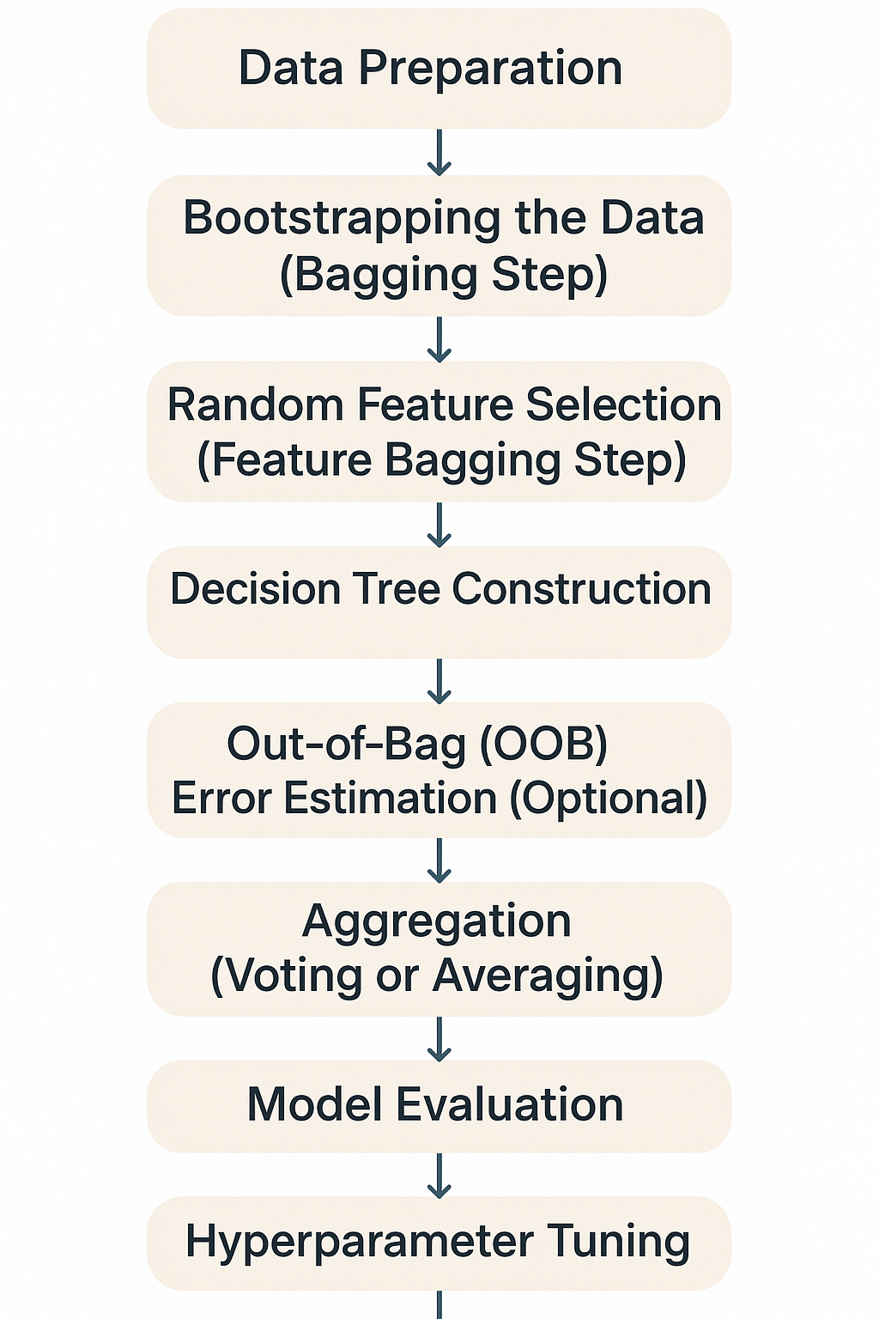
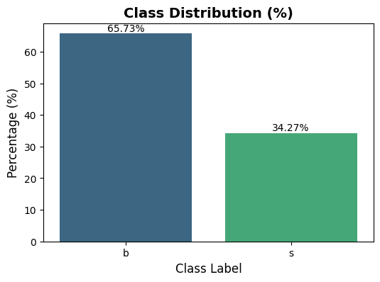
Flow of Random Forest Algorithm
5.Model Training
Fit the model on the training data.
Weighted training may be needed (e.g., sample_weight for particle physics events).
6. Model Evaluation
Evaluate using:
  Training metrics → check for underfitting/overfitting.
  Validation/test metrics → accuracy, ROC-AUC, F1-score, confusion matrix.
  Weighted metrics if events have different importance.
Cross-validation → ensures stability across data splits.
Target Class Distribution

Slide 5
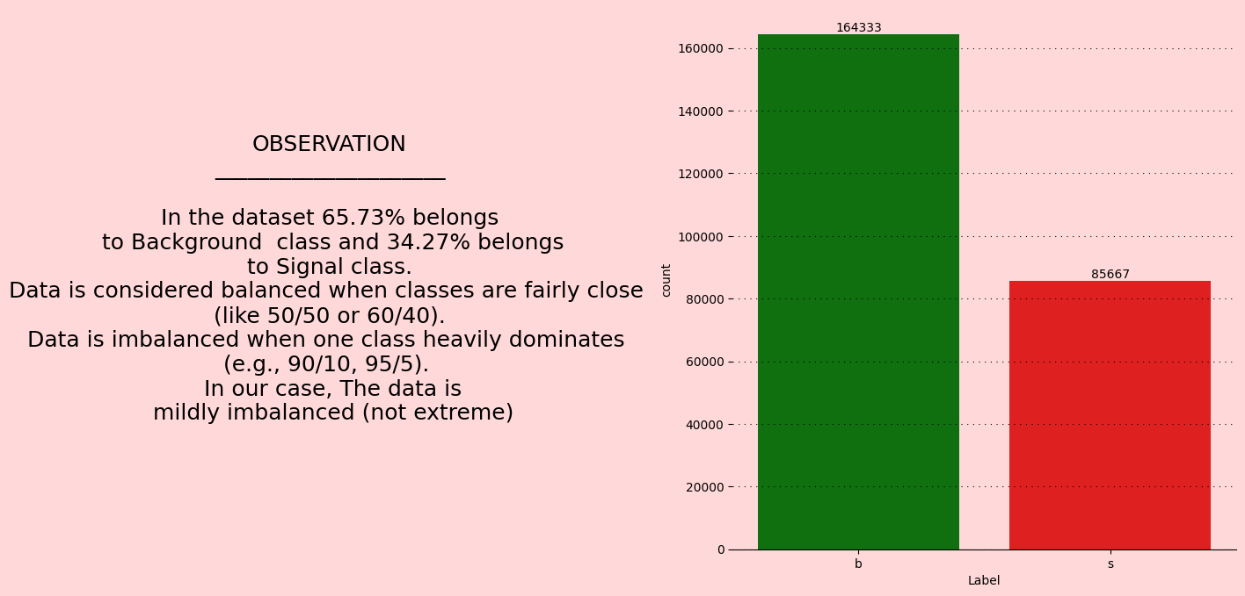
TARGET COLUMNN ANALYSIS

Slide 6
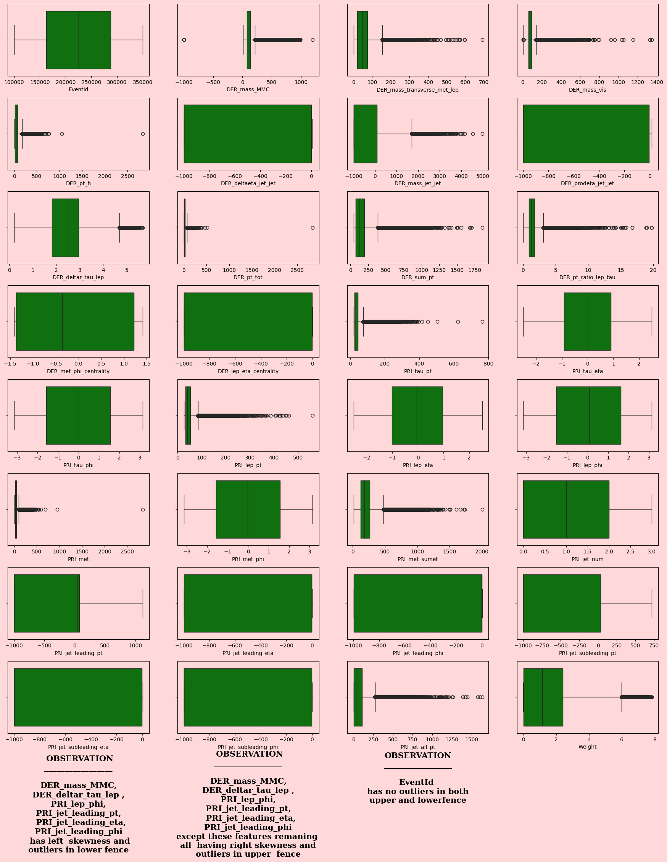
Before Treating Outliers

Slide 7
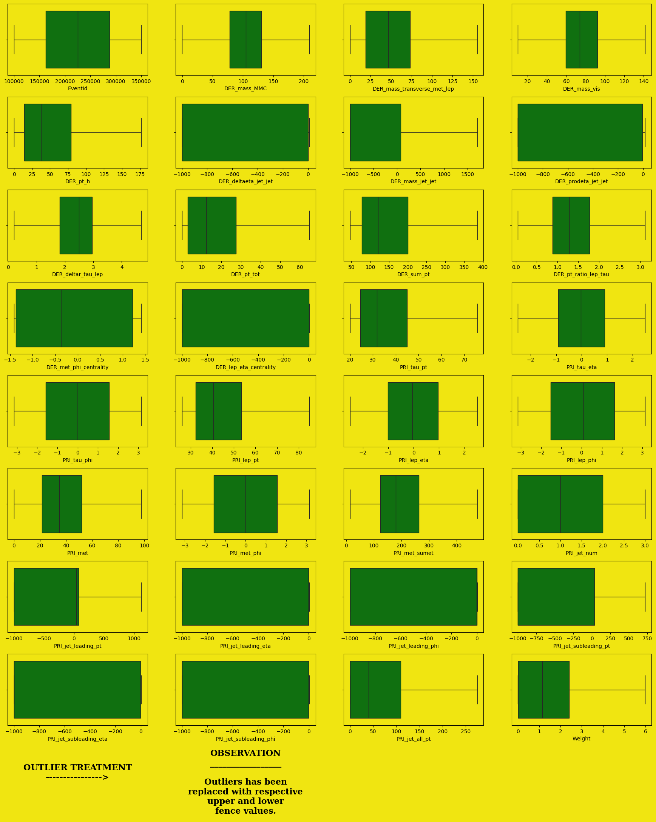
After Treating Outliers

Slide 8
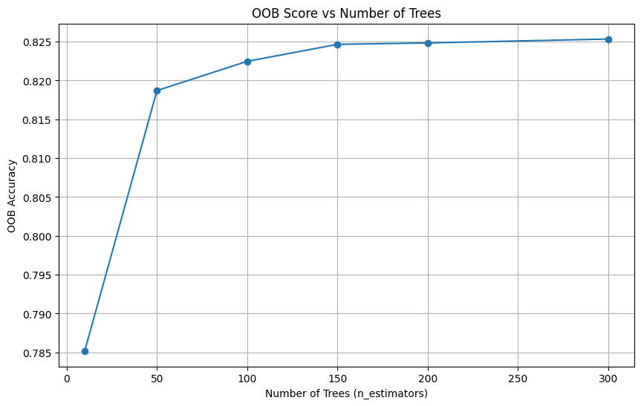
OOB Score vs Number of trees
The biggest improvement happens between 10 → 50 trees.
After 100 trees, the curve flattens out
From 150 trees onwards, there is almost no improvement in OOB accuracy.
So Choosing the n_estimators between 150–200 would be the best choice.

Slide 9
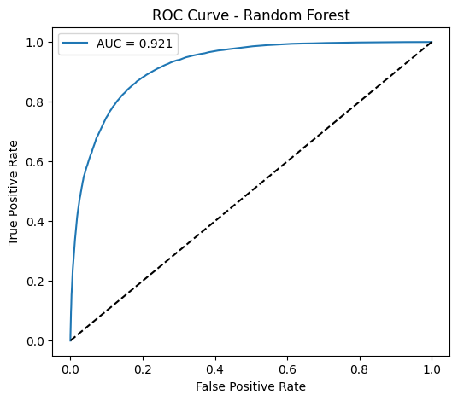
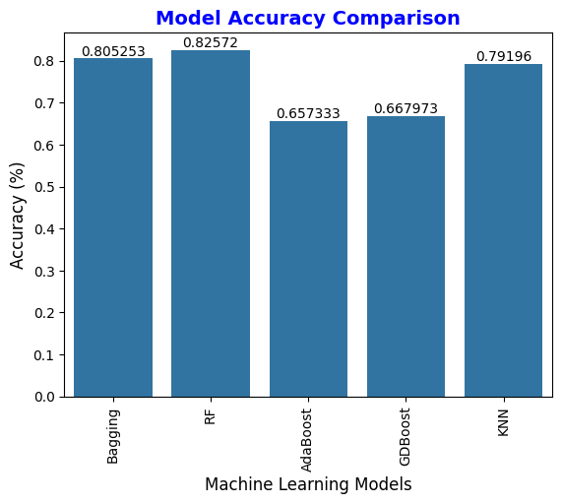
Out of all the model such as Bagging,Random Forest,AdaBoost,GDBoost,KNN----> Random Forest gives high accuracy.

Slide 10
Observations
Data set Contains 250000 rows and 33 columns
There are 32 numerical features and 1 categorical features
The data has 0 duplicate rows.
Label has 2 unique value(i.e "s"- > Signal,"b"-> Background noise)
The target label proportion is "b" ->65.73% and "s"-> 34.27%.The data is midly imbalaced data.
The target label( Background Contains - 164333 dp's and Signal contains-> 85667 dp's)
No of Integer columns : 2
No of float columns: 30
No of Object columns:1
There are 0 duplicated rows
11. For treating outliers, applied Winsorization using IQR (also called fence method).
12. Training Accuracy Score(unweighted): 100.0
13. Training Accuracy Score(weighted): 100.0 %
14. Testing Accuracy Score (unweighted): 82.67 %
15. Testing Accuracy Score (weighted): 91.65 %
16. ROC AUC (weighted): 92.09 %
17. Cross validation Training Score 83.75
18. Testing Accuracy Score: 82.63 %
19. Bagging Accuracy 0.805253
20. RF Accuracy 0.825720
21.AdaBoost Accuracy 0.657333
22 GDBoost Accuracy 0.667973
23. KNN Accuracy 0.791960
24. Out of all the model such as Bagging,Random Forest,AdaBoost,GDBoost,KNN----> Random Forest gives high accuracy.

